Slide 1
Color Categories in Monkeys
Daniel Garside
Colour Group (GB) - January Vision Meeting
5th Jan 2022
Notes:
Source: https://irp.nih.gov/brand-materials/irp-powerpoint-templates
Event: https://www.colour.org.uk/january-vision-meeting-2022/

Slide 2
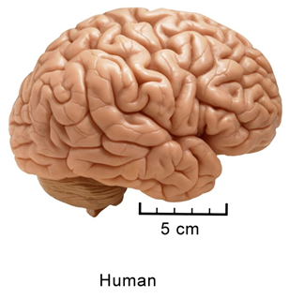
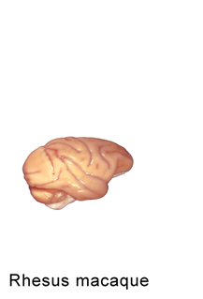
Human vs macaque
Electrode recording
Electrode recording
Psychophysics
Psychophysics

Slide 3
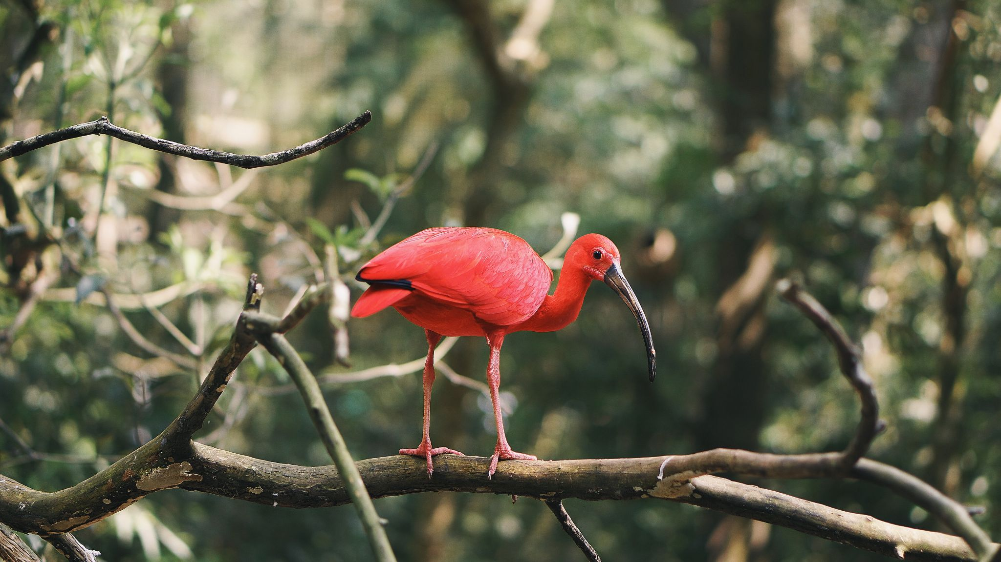
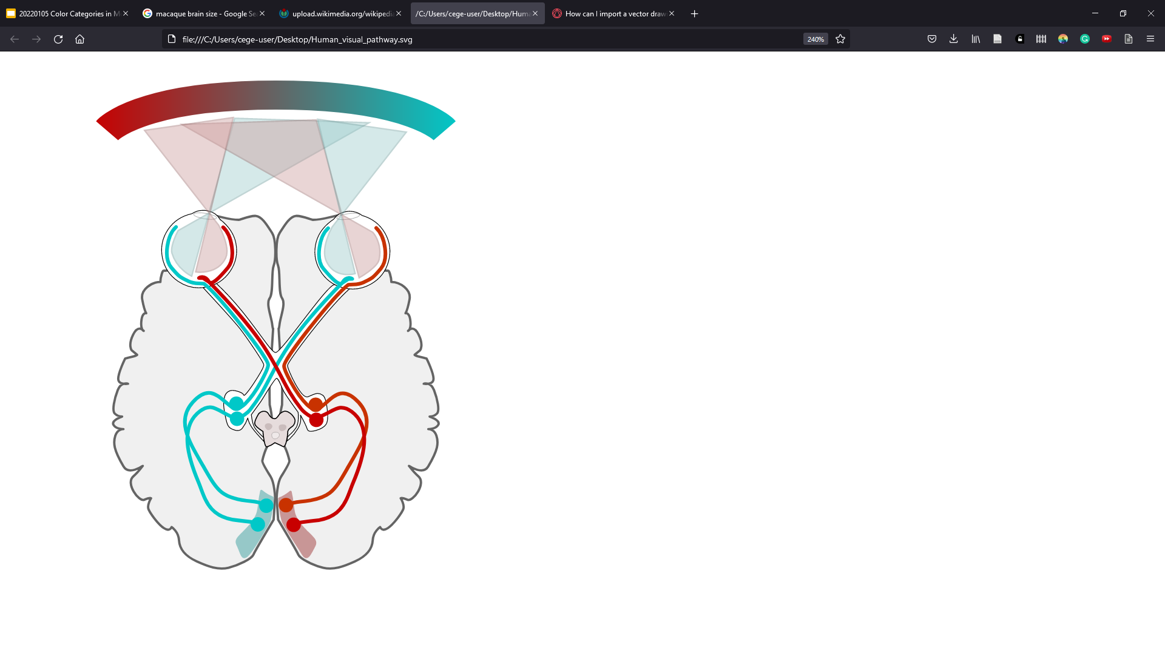
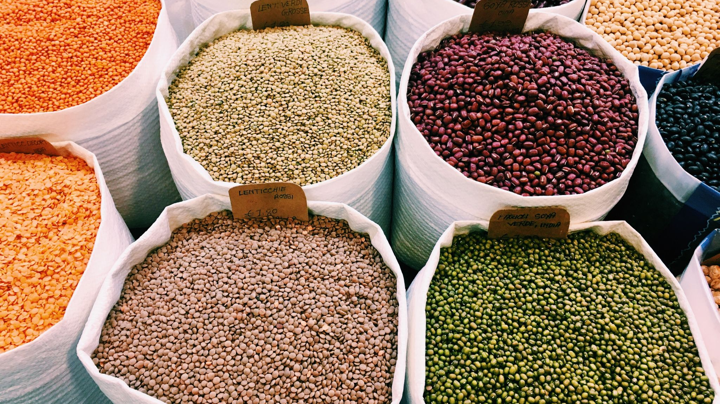
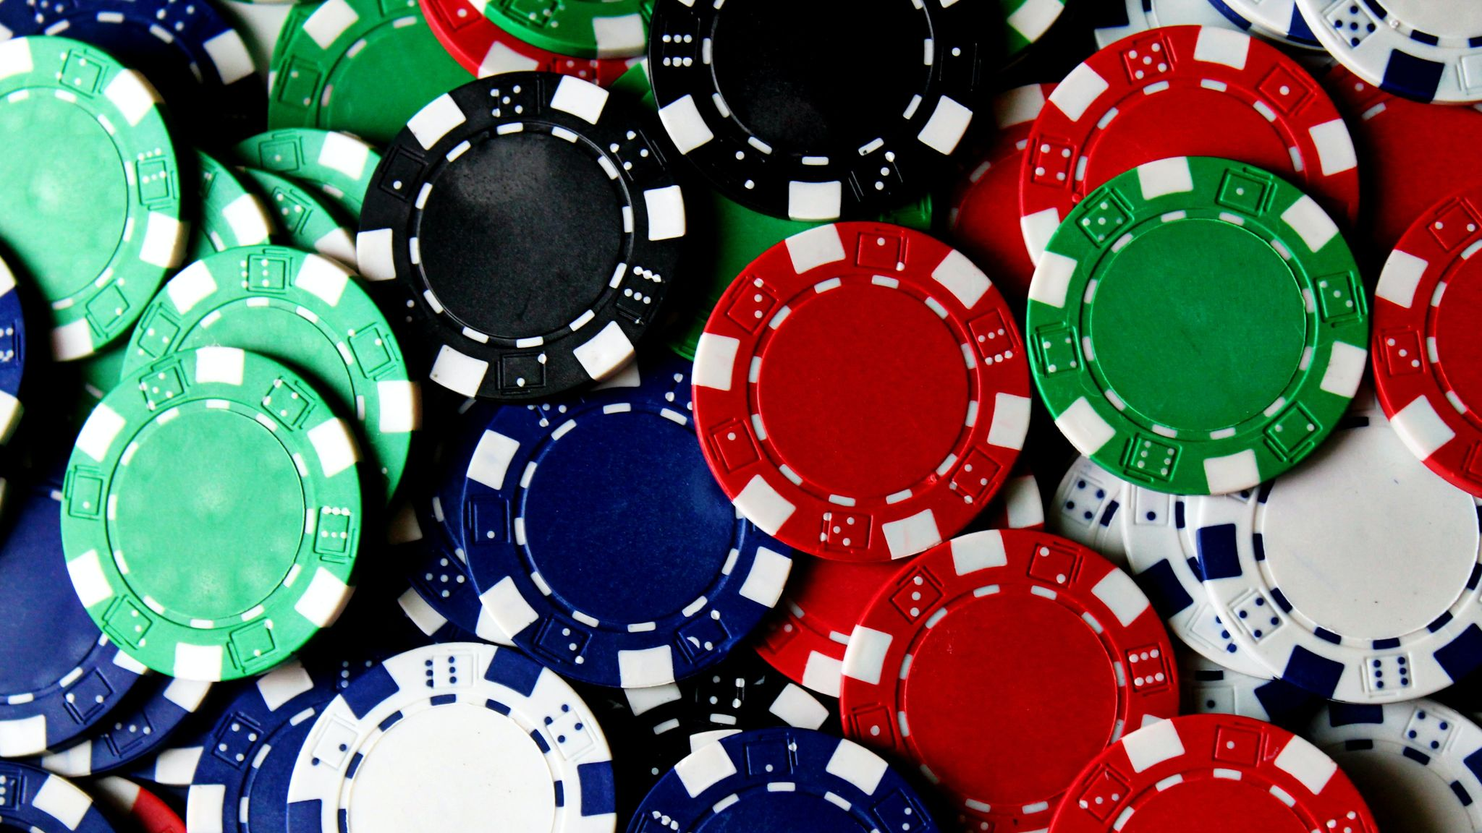
Different levels of color
Receptoral
Post-receptoral
V1
Extra-striate
Notes:
Image: Miquel Perello Nieto

Slide 4
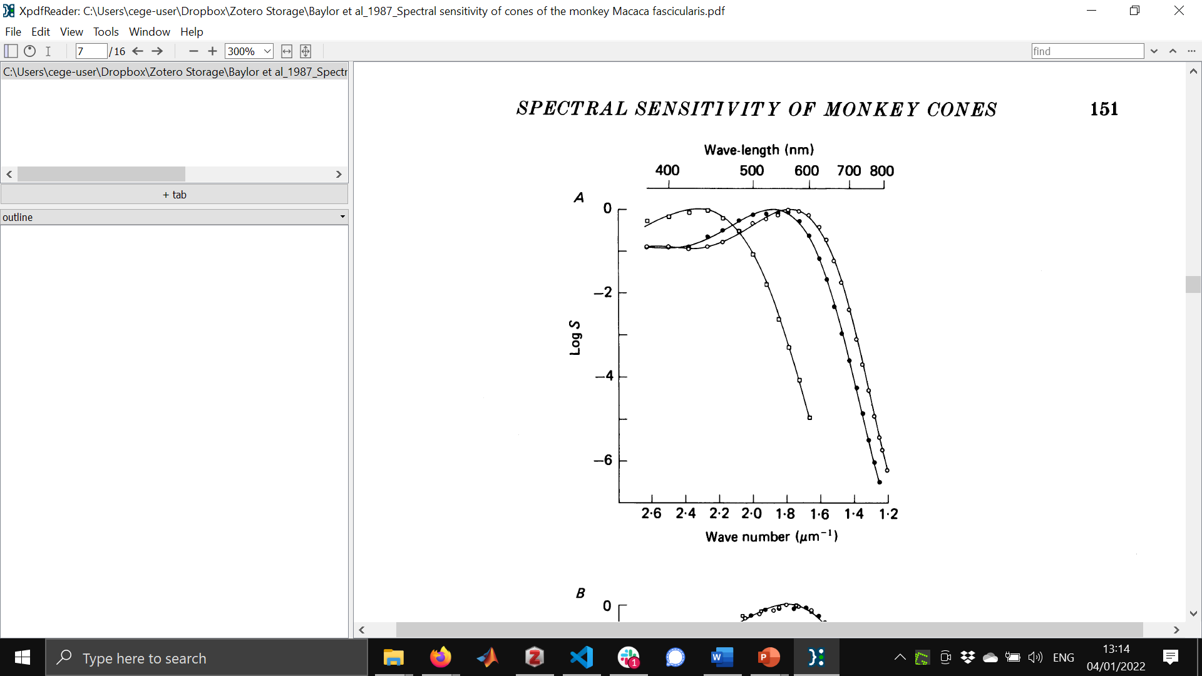
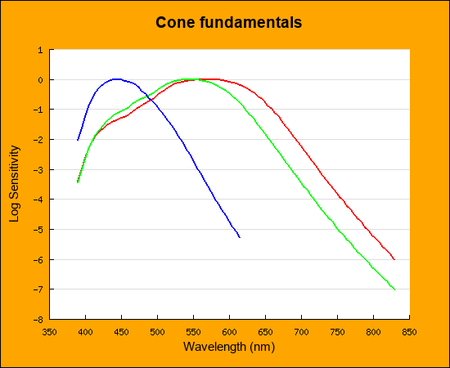
Receptoral
Macaque
Human
Baylor (1987)
Stockman & Sharpe (2000)
Notes:
Image: Miquel Perello Nieto

Slide 5
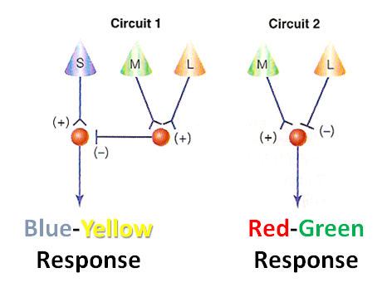
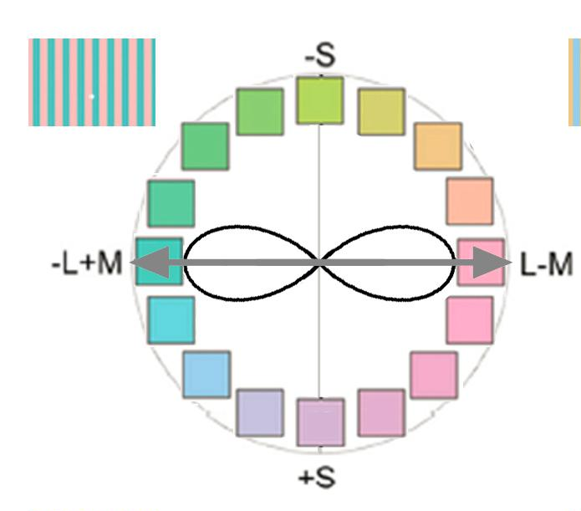
Post-receptoral
Prediction
If there is a neural mechanism selective for the adaptation colors
🡪 increased detection thresholds for those colors
S - (L + M)
L - M

Slide 6
Standard Model, predicted changes in detection threshold

Slide 7
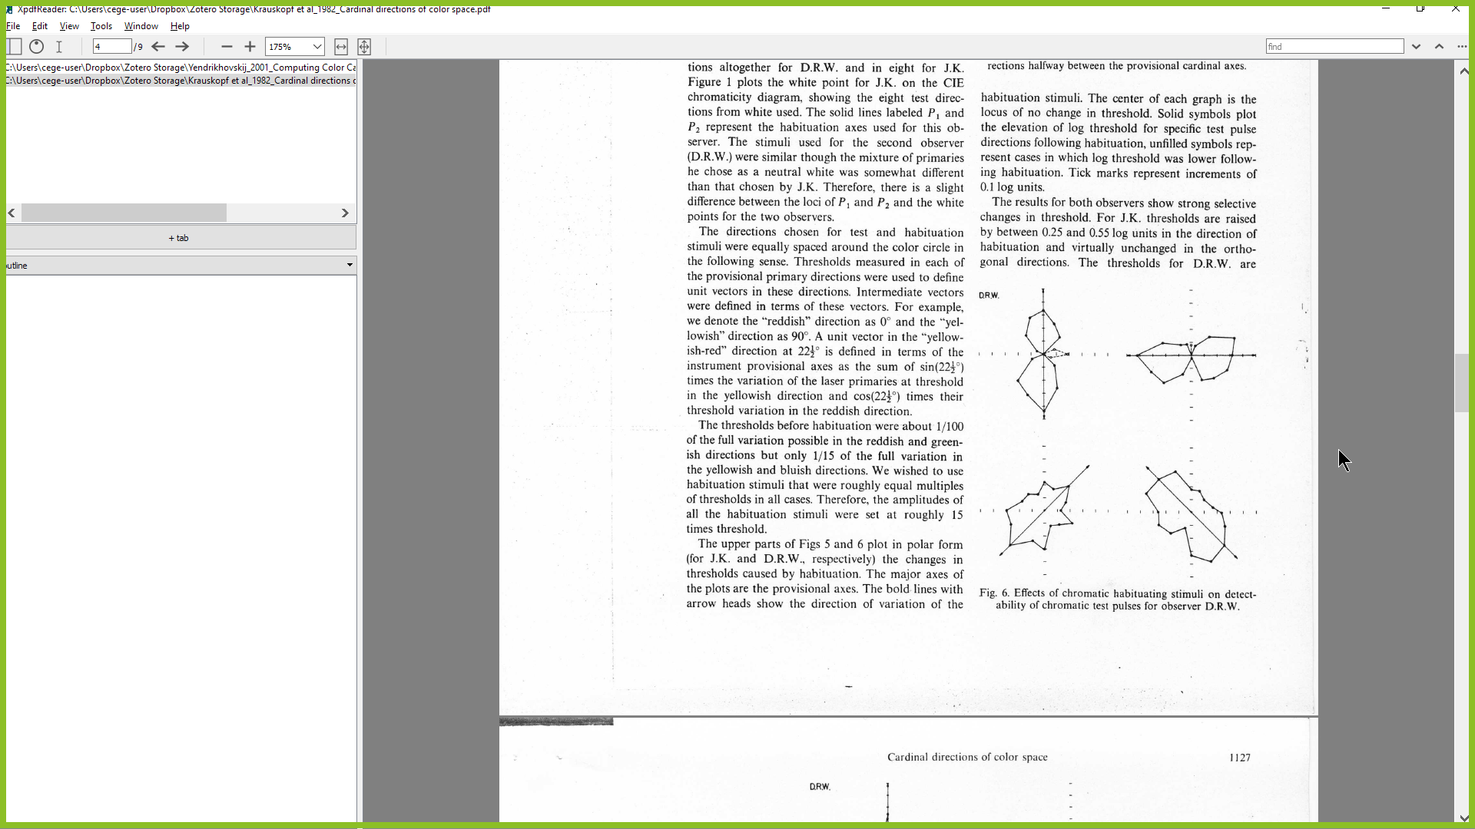
Standard Model, predicted changes in detection threshold
Human data - Krauskopf (1982)

Slide 8
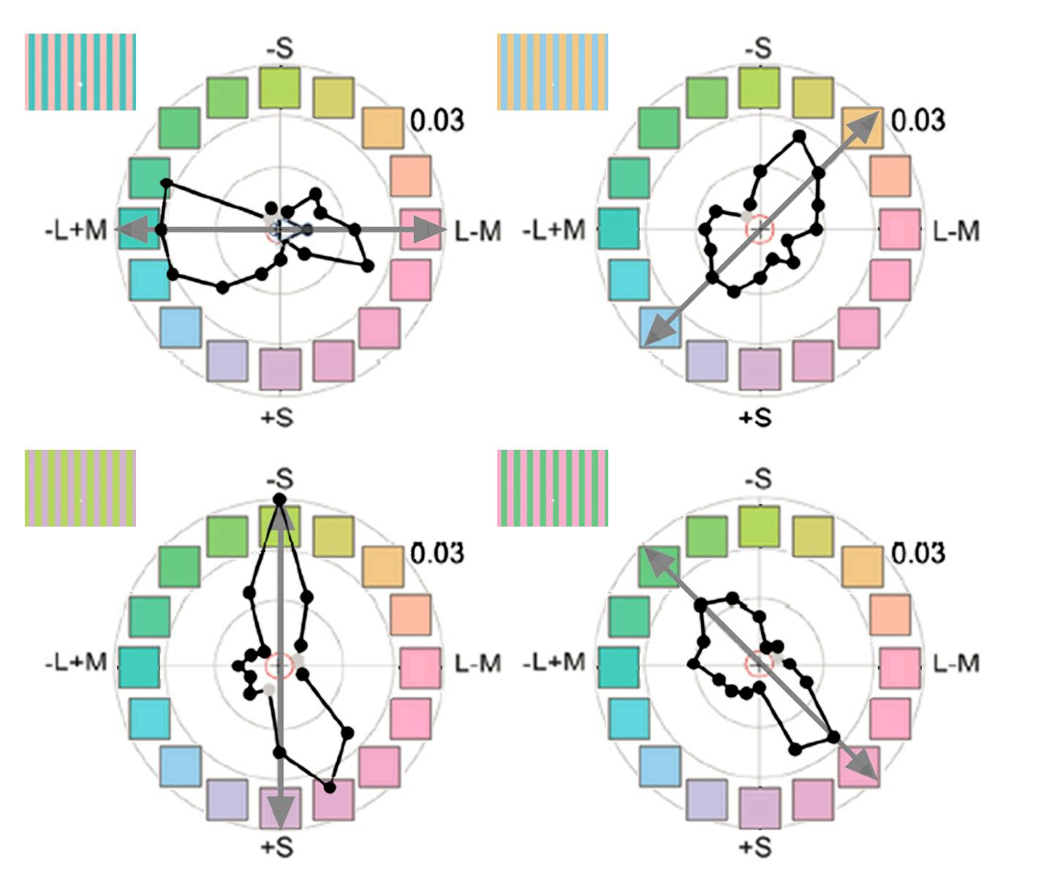
Standard Model, predicted changes in detection threshold
Human data - Krauskopf (1982)
Stoughton et al. (2012) J Neurosci
Gagin et al. (2014) J. Vision

Slide 9
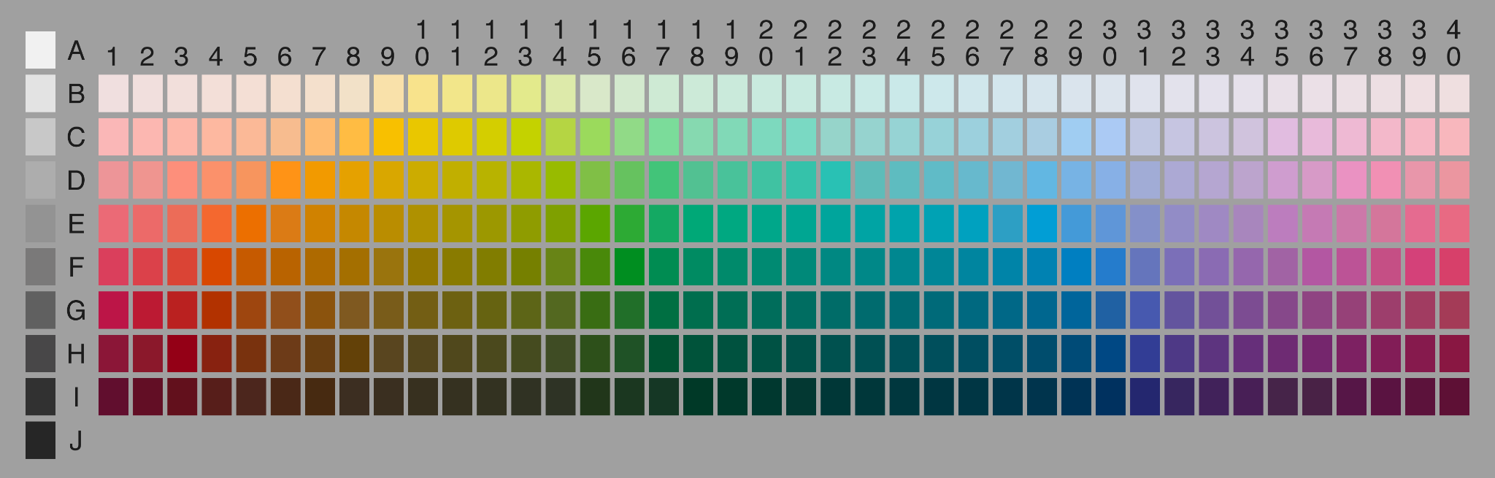
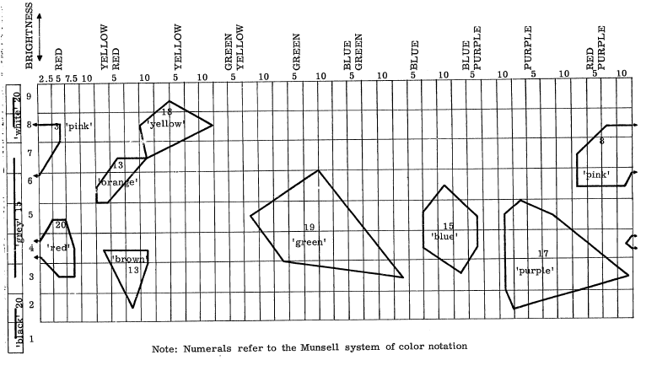
Verbal tests
Berlin and Kay (1969)
Notes:
https://www1.icsi.berkeley.edu/wcs/data.html

Slide 10
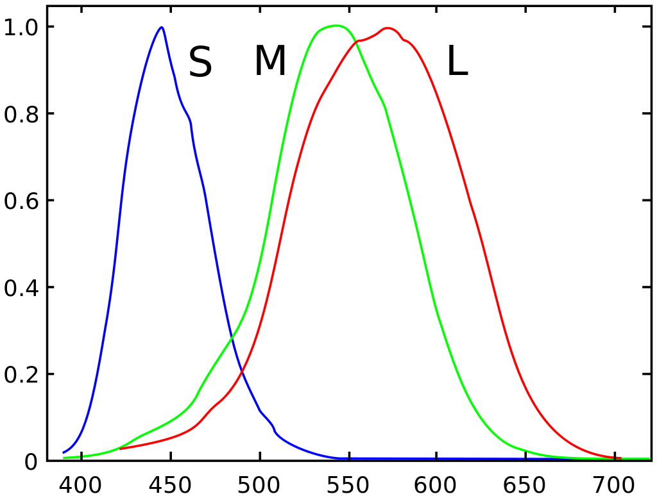
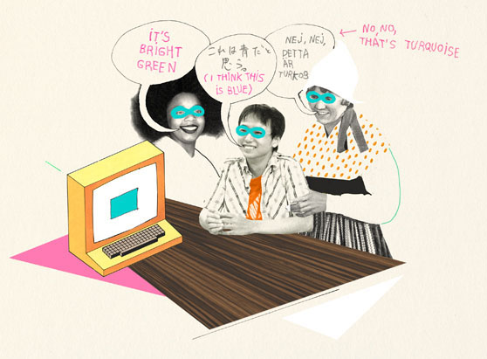
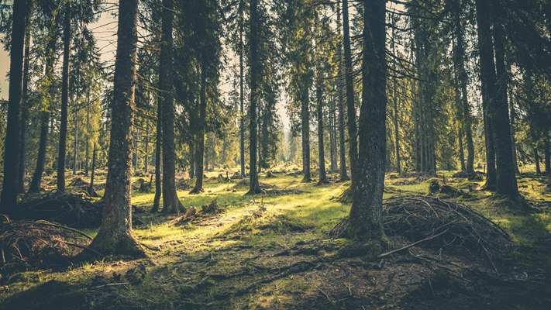
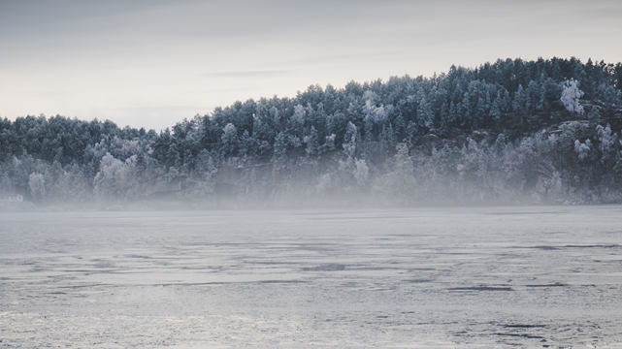
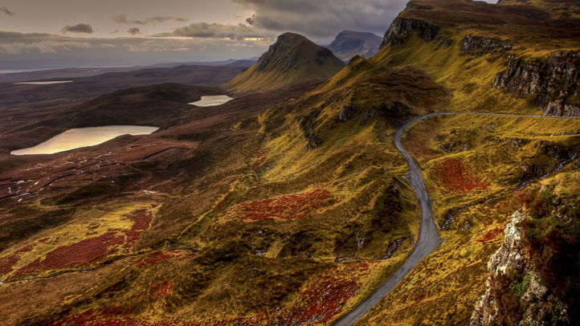

Theories of Color Categorization
Learned factors
Innate factors
Cone spectral absorption functions
Verbal communication of color
Valero Doval for colornaming.net
Color statistics of natural scenes

Slide 11
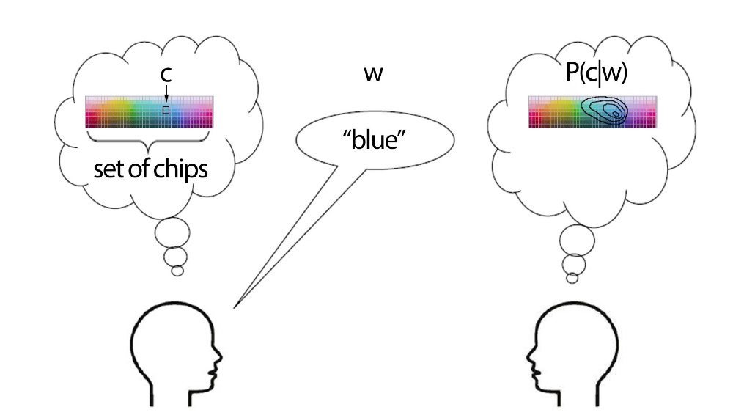
I pick a specific color chip and use a word to describe it
Gibson et al, PNAS 2017

Slide 12
I pick a specific color chip and use a word to describe it
How many guesses do you need to figure out the color?
Gibson et al, PNAS 2017

Slide 13
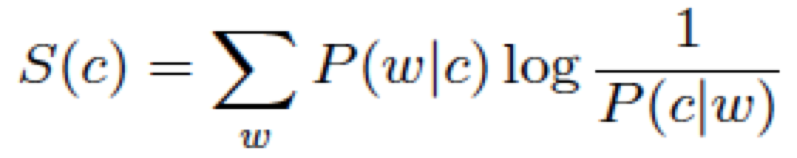
I pick a specific color chip and use a word to describe it
How many guesses do you need to figure out the color?
Gibson et al, PNAS 2017

Slide 14
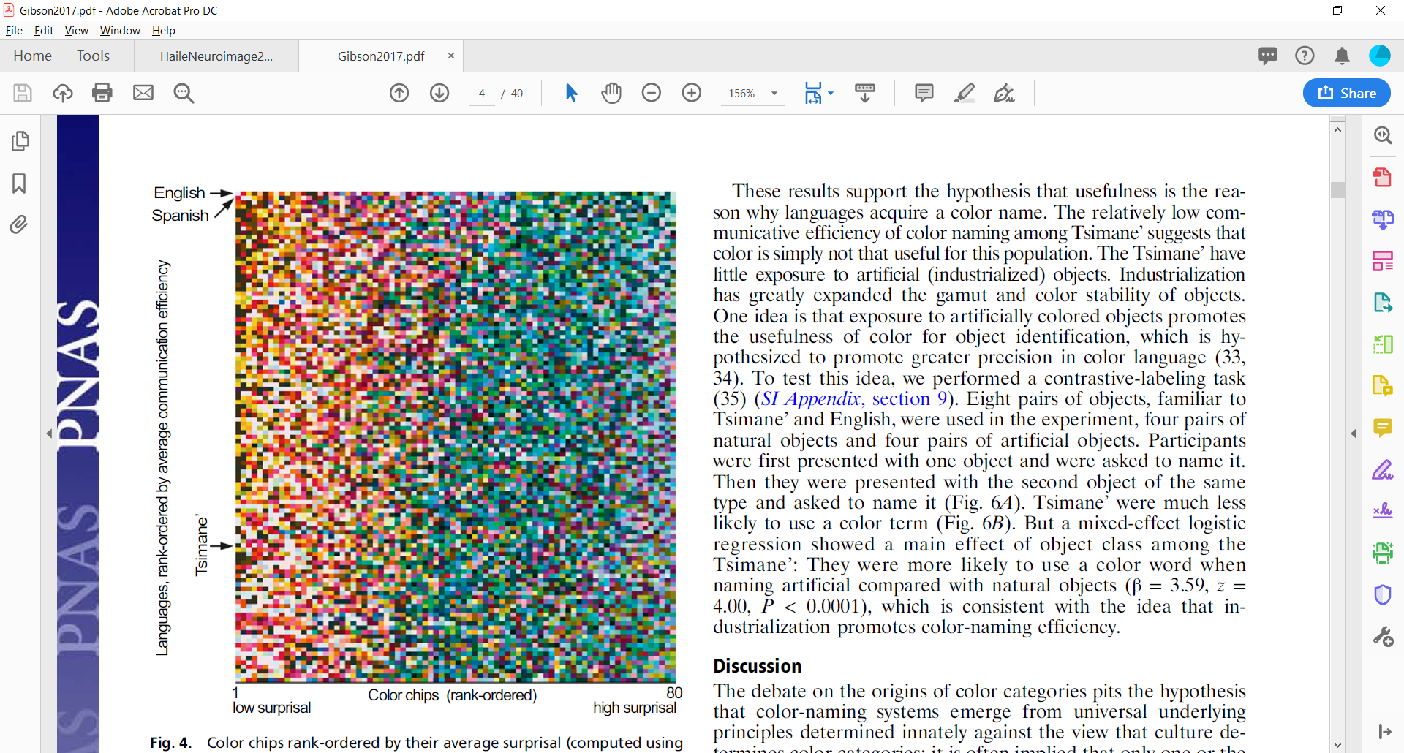
All languages show higher communicative efficiency for warm over cool colors
I pick a specific color chip and use a word to describe it
How many guesses do you need to figure out the color?
Gibson et al, PNAS 2017

Slide 15
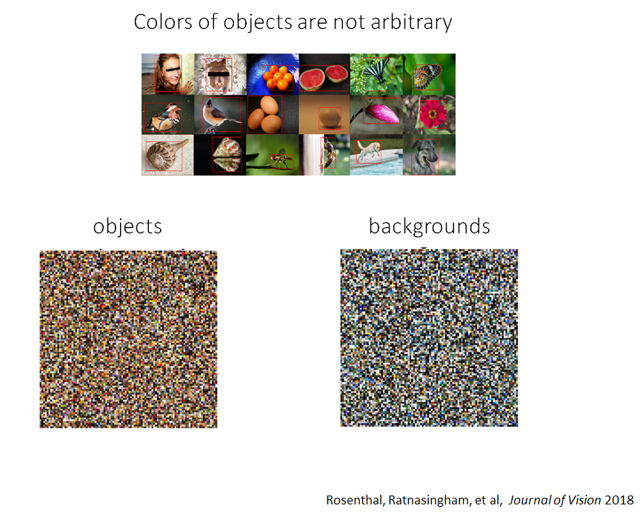

Slide 16
Signatures of categorical behavior
Smaller discrimination thresholds across category borders
Bias towards
best exemplar of category (“focal color”)
Category 1
Category 2
Category 1
Category 2

Slide 17
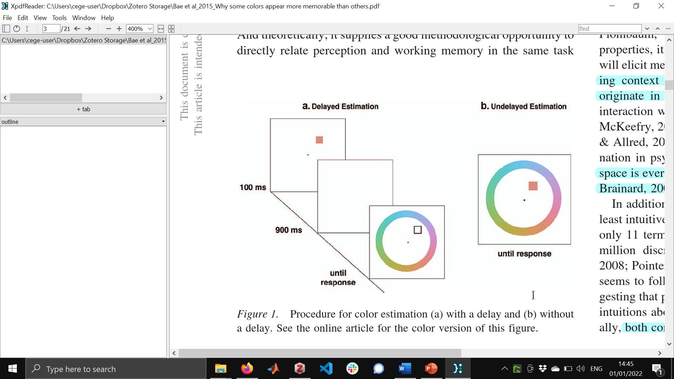
Bae et al. (2015) JEP:G

Slide 18
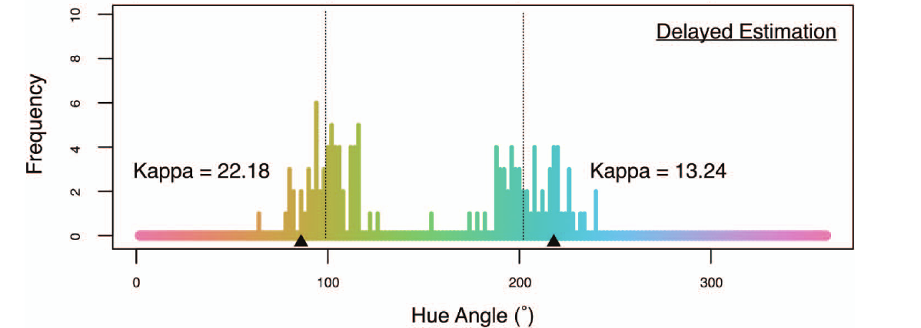
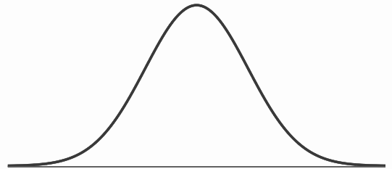
Bae et al. (2015) JEP:G

Slide 19
Bae et al. (2015) JEP:G

Slide 20
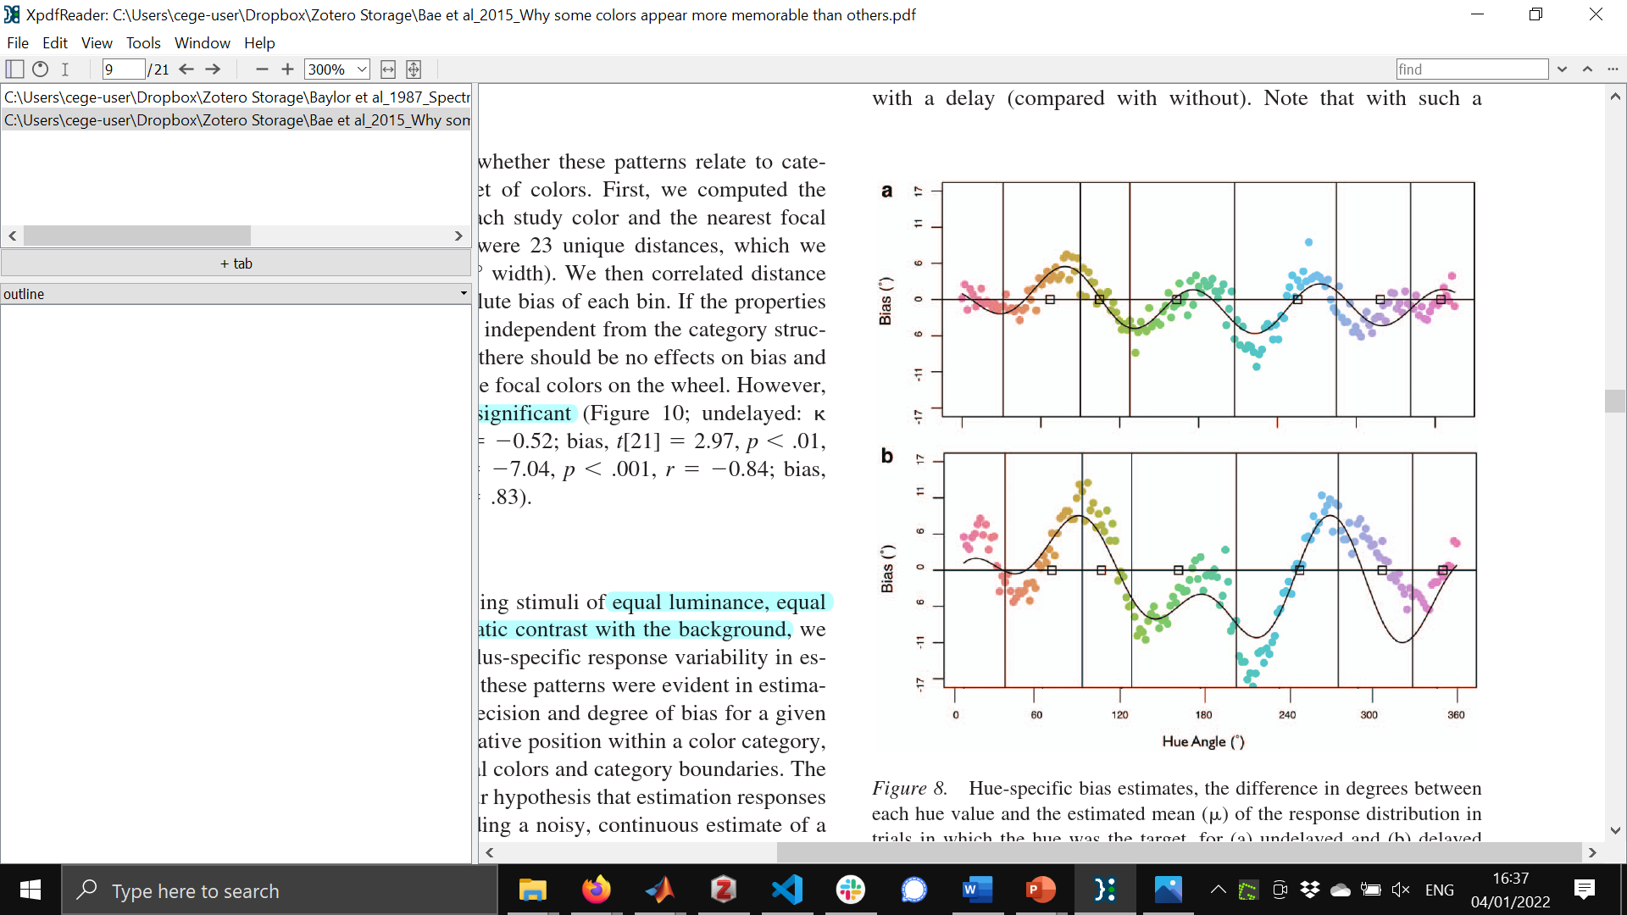
Bae et al. (2015) JEP:G

Slide 21
Attractor points
Bae et al. (2015) JEP:G

Slide 22
Bae et al. (2015) JEP:G

Slide 23
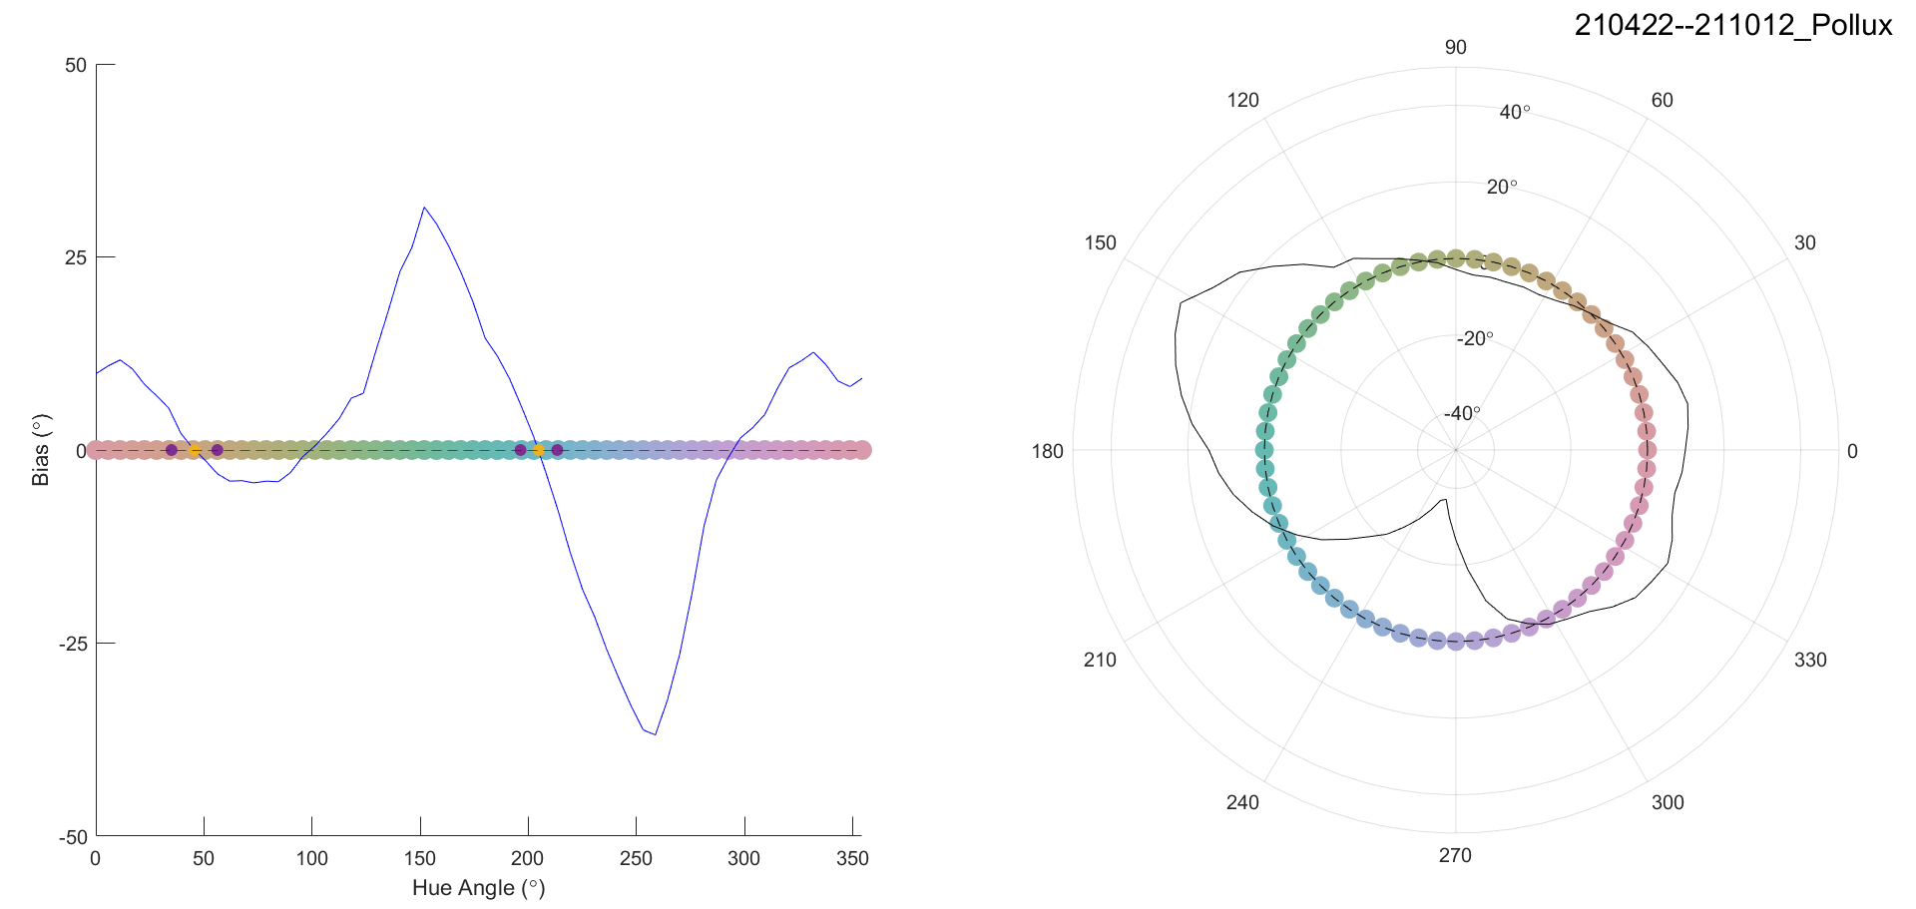
Bae et al. (2015) JEP:G
-25 0 25

Slide 24
Bae et al. (2015) JEP:G
M1
-25 0 25

Slide 25
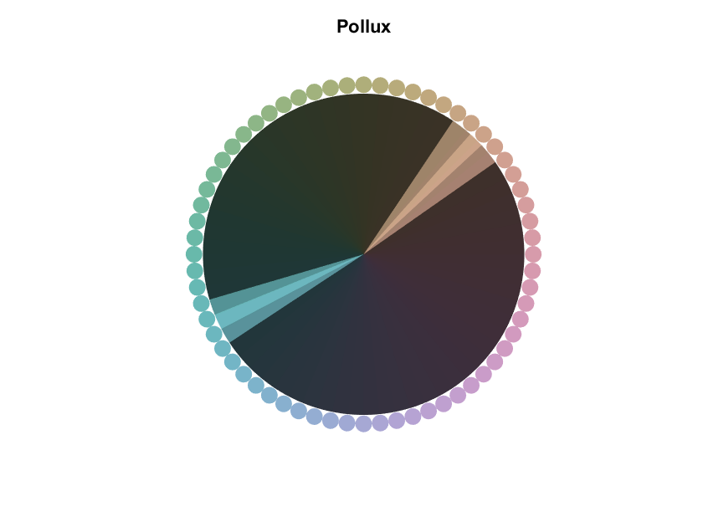
Locations of categories
M1

Slide 26
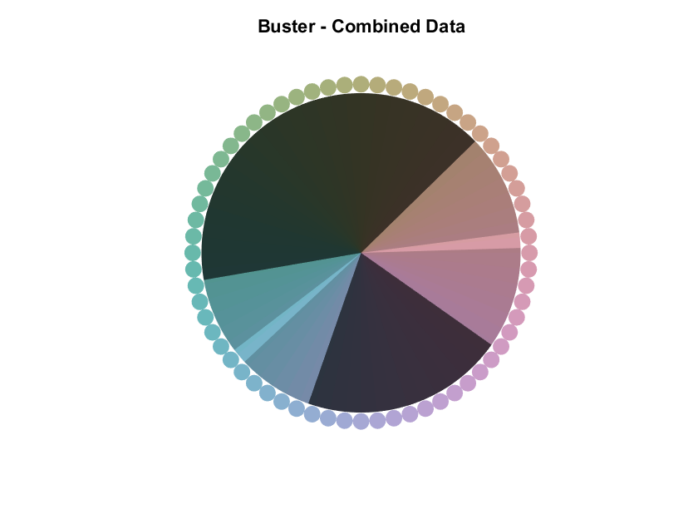
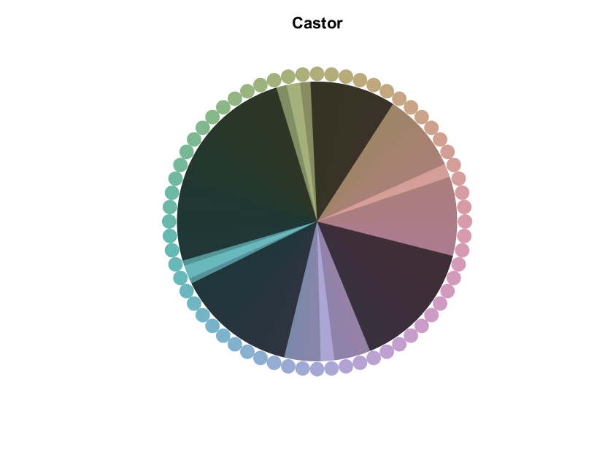
Locations of categories
M1
M2
M3

Slide 27
Locations of categories
Category gradient values: a measure of attractor strength (range: 0 - 90)
M1
M2
M3
65.2
72.3
56.3
78.4
53.7
78.4
67.2
6.9

Slide 28
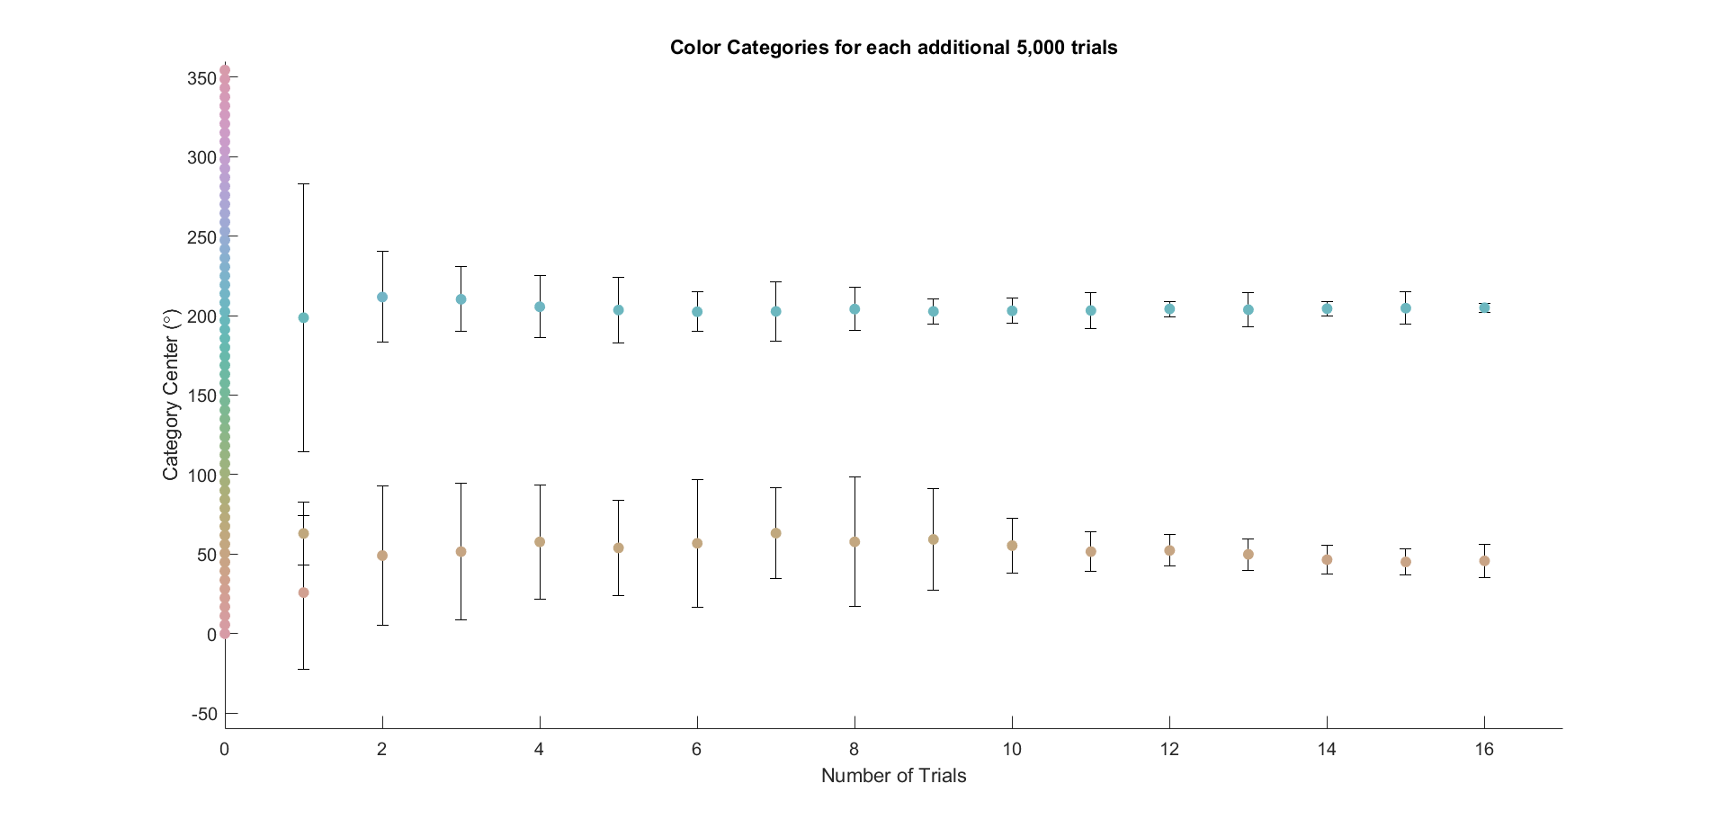
Power analysis
Hue
0 10 20 30 40 50 60 70 80
M1
Number of trials (x1000)

Slide 29
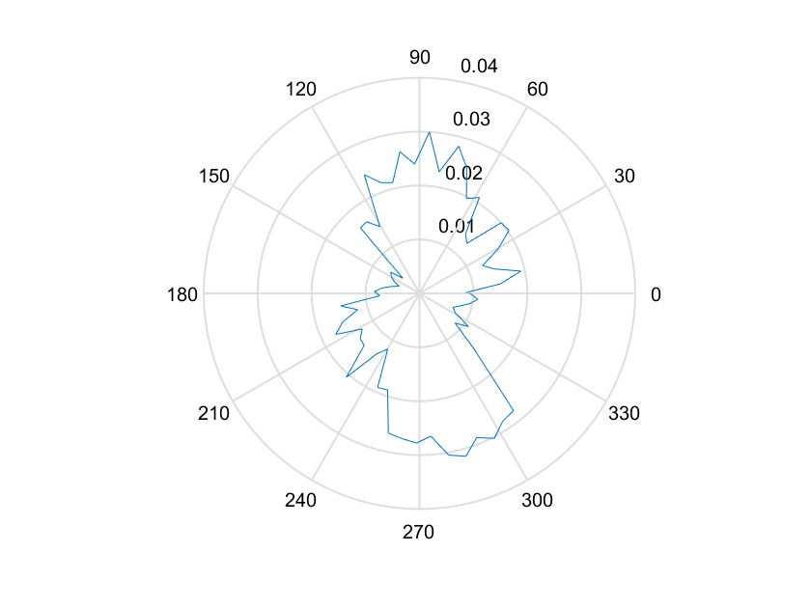
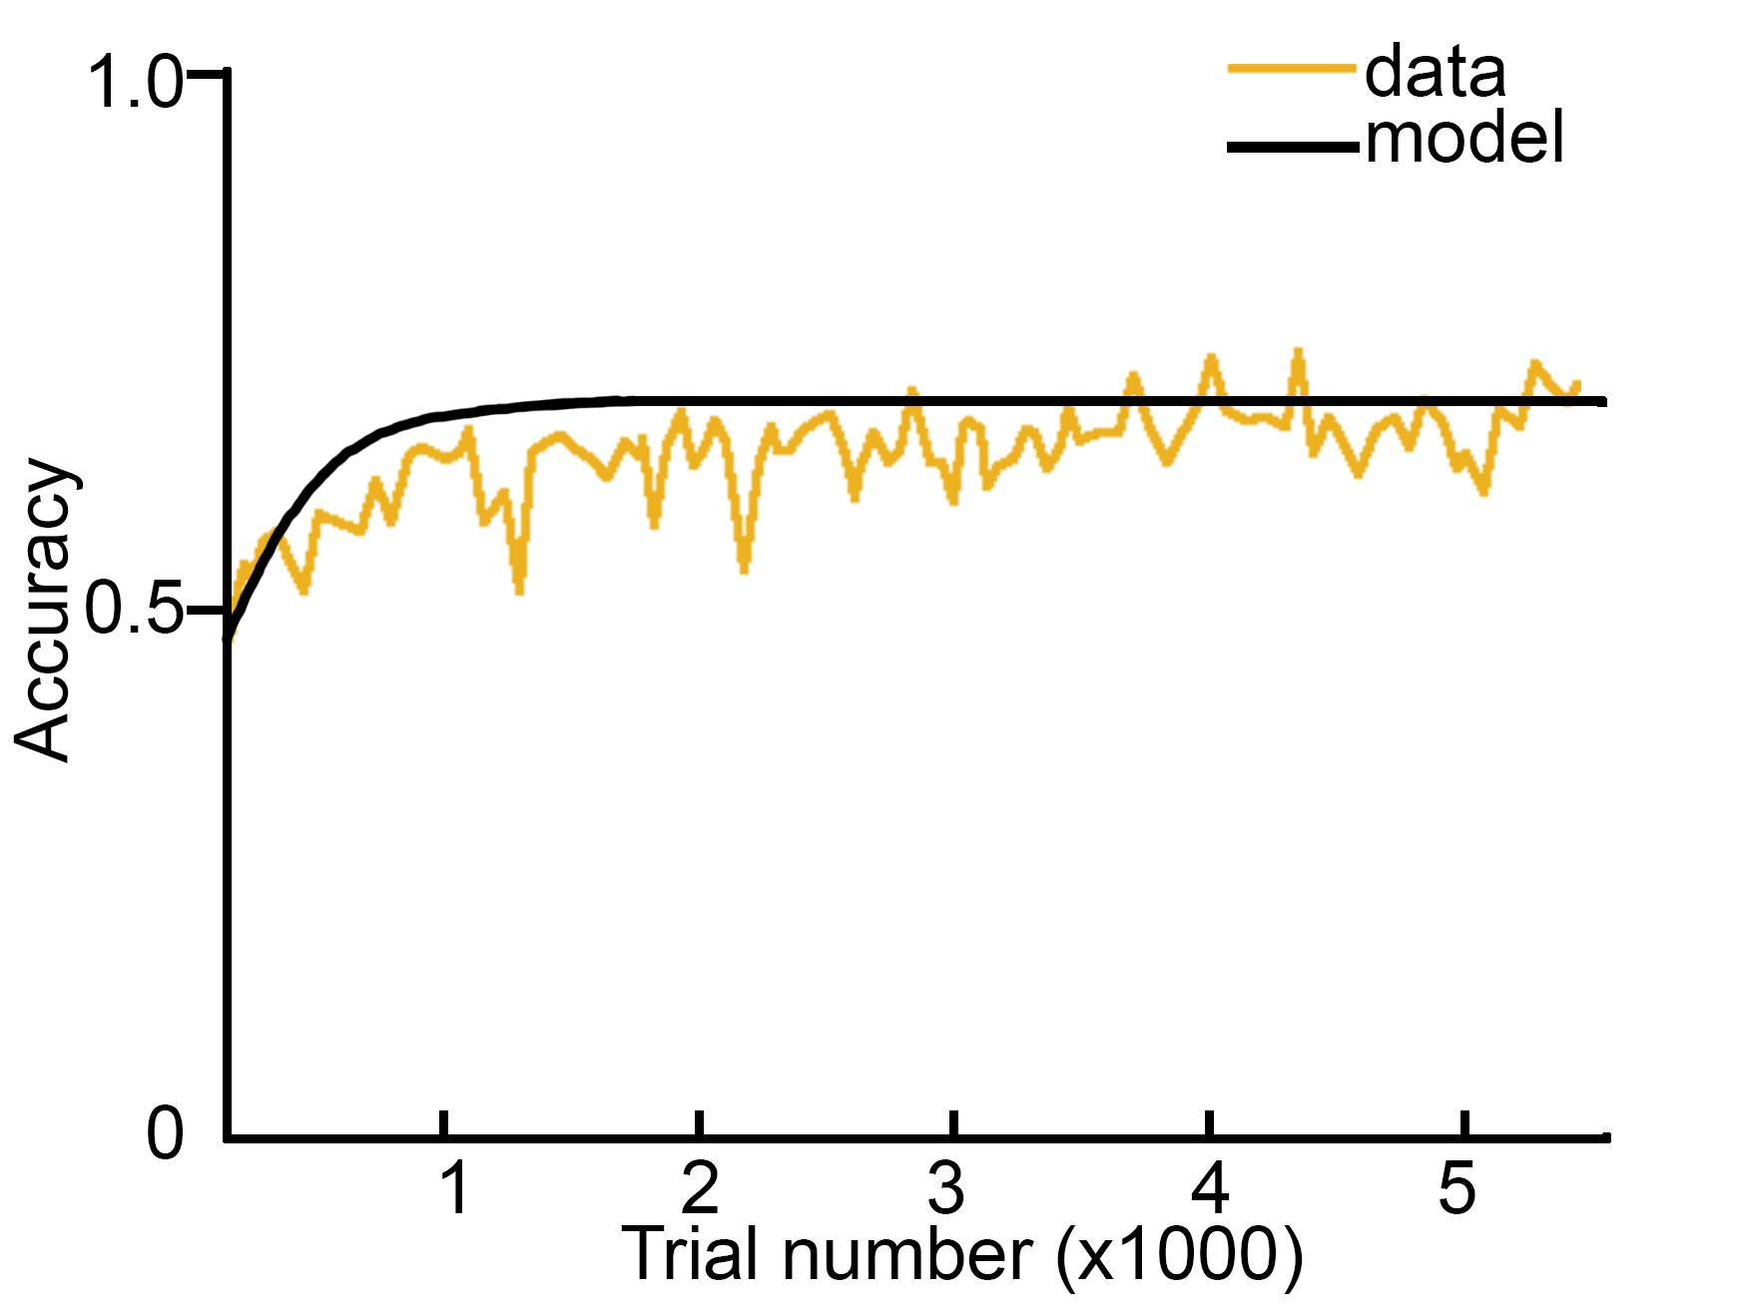
Learning rates
Learning rate
for a single hue
Learning rates
as a function of hue
DKL axis directions

Slide 30
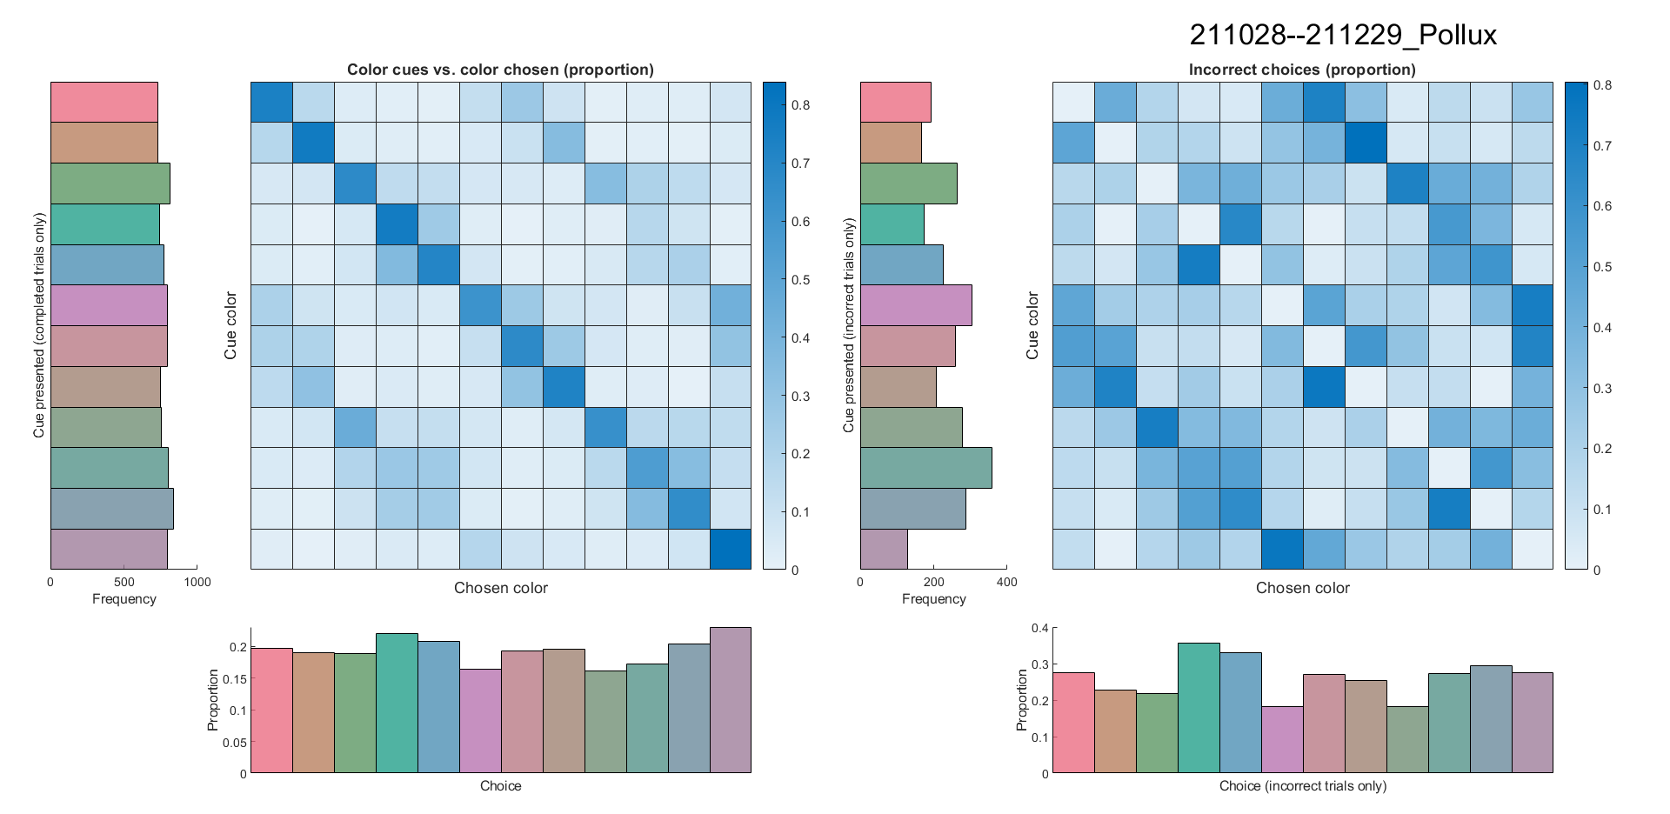
Multiple-satuation data heatmaps
Cue
Choice

Slide 31
Multiple-satuation data heatmaps
Cue
Choice

Slide 32
Multiple-satuation data heatmaps
Cue
Choice

Slide 33
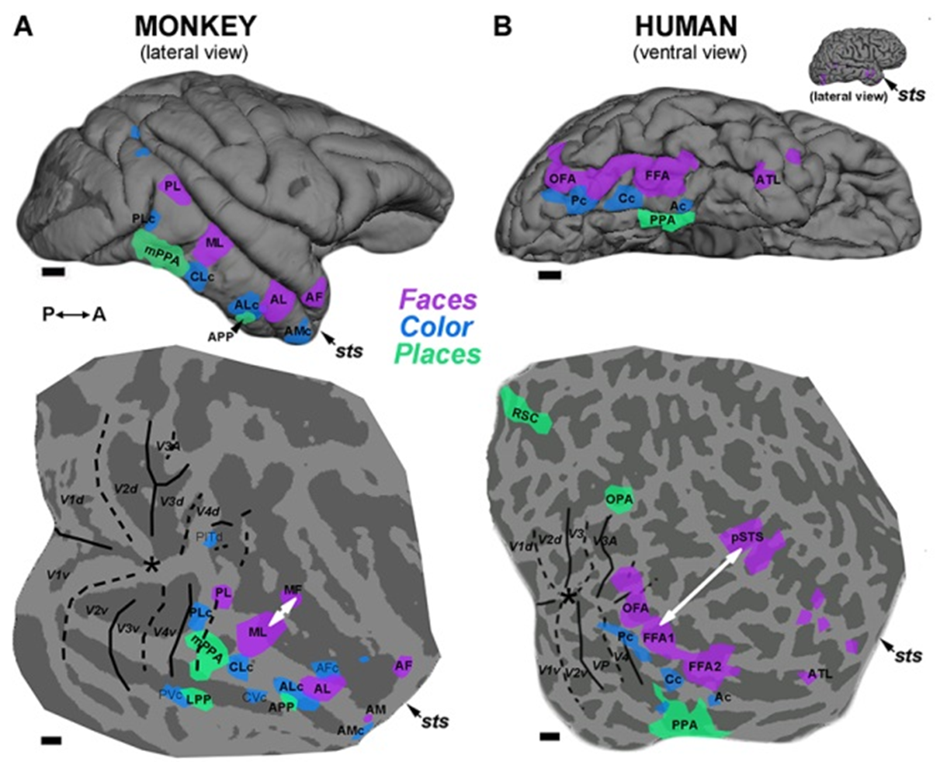

Slide 34
Conclusions
There are two color categories that are common to all 3 monkeys
These color categories correspond to the human distinction of warm and cool
The underlying template for the fundamental structure of color categories for trichromatic primates appears universal, potentially determined by the color statistics of relevant parts of scenes (objects)

Slide 35
Acknowledgements
Bevil Conway
Audrey Chang
Hannah Selwyn
Shriya Awasthi
Whitney Teagle
Riley Hoffman
NIH IRP funding
Animal care staff

Slide 36
Thank you!

